Slide 1


Poliomyelitis

Slide 2

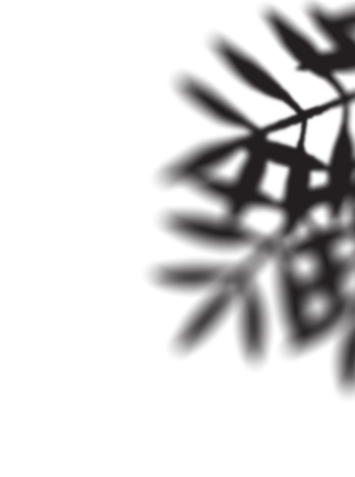
Primarily an infection of the human alimentary tract
Virus may infect the central nervous system in a very small percentage (about 1 per cent) of cases resulting in varying degrees of paralysis, and possibly death.
Incubation period - Usually 7 to 14 days (range 3 to 35 days)

Slide 3
Epidemiology: Agent
Poliovirus (RNA virus) - three serotypes 1,2 and 3. Most outbreaks of paralytic polio are due to type-1 virus.
Poliovirus can survive for long periods in the external environment. In a cold environment, it can live in water for 4 months and in faeces for 6 months.
Well-adapted for the faecal-oral route of transmission.
RESERVOIR OF INFECTION : Man is the only known reservoir of infection.
Most infections are subclinical. It is the mild and subclinical infections that play a dominant role in the spread of Infection.
It is estimated that for every clinical case, there may be 1000 subclinical cases in children and 75 in adults.
There are no chronic carriers. No animal source has yet been demonstrated.

Slide 4
Epidemiology: Agent
INFECTIOUS MATERIAL : The virus is found in the faeces and oropharyngeal secretions of an infected person.
PERIOD OF COMMUNICABILITY :
The cases are most infectious 7 to 10 days before and after onset of symptoms.
In the faeces, the virus is excreted commonly for 2 to 3 weeks, sometimes as long as 3 to 4 months.

Slide 5
Epidemiology: Host
AGE : The disease occurs in all age groups.
Children are usually more susceptible than adults because of the acquired immunity of the adult population.
In developed countries, before the advent of vaccination, the age distribution shifted so that most patients were over the age of 5 years, and 25 per cent were over age 15 years.
In India, polio is essentially a disease of infancy and childhood.
About 50 per cent of cases are reported in infancy.
The most vulnerable age is between 6 months and 3 years,
SEX : Sex differences have been noted in the ratio of 3 males to one female

Slide 6
Epidemiology: Host
RISK FACTORS : They include fatigue, trauma, intramuscular injections, operative procedures such as tonsillectomy undertaken especially during epidemics of polio and administration of immunizing agents particularly alum-containing DPT.
IMMUNITY :
The maternal antibodies gradually disappear during the first 6 months of life.
Immunity following infection is fairly solid although reinfection can occur since infection with one type does not protect completely against the other two types of viruses.
Type-2 virus appears to be the most effective antigen.
Neutralizing antibody is widely recognized as an important index of immunity to polio after infection

Slide 7
Epidemiology: Environment
Polio is more likely to occur during the rainy season.
Approximately 60 per cent of cases recorded in India were during June to September.
The environmental sources of infection are contaminated water, food and flies.
Polio virus survives for a long time in a cold environment.
Overcrowding and poor sanitation provide opportunities for exposure to infection.

Slide 8
Mode of transmission
FAECAL-ORAL ROUTE : This is the main route of spread in developing countries.
The infection may spread directly through contaminated fingers where hygiene is poor, or indirectly through contaminated water, milk, foods, flies and articles of daily use.
DROPLET INFECTION : This may occur in the acute phase of disease when the virus occurs in the throat. Close personal contact with an infected person facilitates droplet spread.
This mode of transmission may be relatively more important in developed countries where faecal transmission is remote.

Slide 9

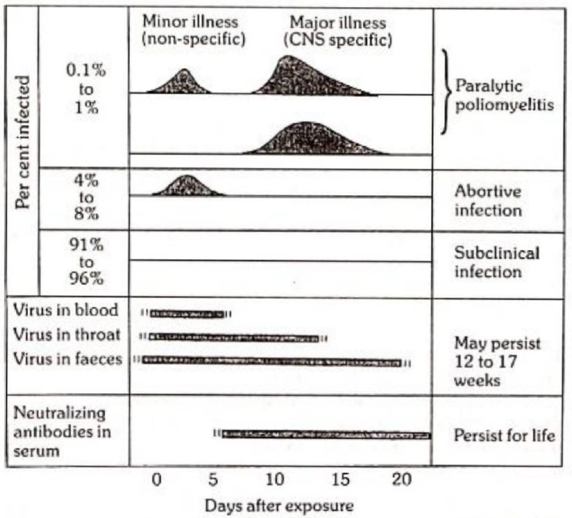
Clinical spectrum

Slide 10
Clinical spectrum
INAPPARENT (SUBCLINICAL) INFECTION :
There are no presenting symptoms.
Recognition only by virus isolation or rising antibody titres.
ABORTIVE POLIO OR MINOR ILLNESS :
It causes only a mild or self-limiting illness due to viraemia.
The patient recovers quickly.
The diagnosis cannot be made clinically. Recognition only by virus isolation or rising antibody titre,
NON-PARALYTIC POLIO :
The presenting features are stiffness and pain in the neck and back.
The disease lasts 2 to 10 days. Recovery is rapid.
The disease is synonymous with aseptic meningitis.

Slide 11
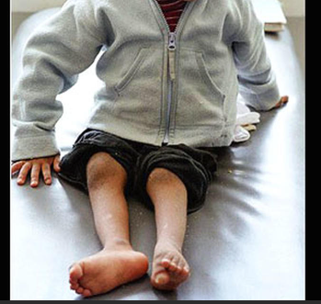
Paralytic polio
The virus invades CNS and causes varying degrees of paralysis.
The predominant sign is asymmetrical flaccid paralysis.
A history of fever at the time of onset of paralysis is suggestive of polio.
The other associated symptoms are malaise, anorexia, nausea, vomiting, headache, sore throat, constipation and abdominal pain.
There might be signs of meningeal irritation, i.e., stiffness of neck and back muscles.
Tripod sign may be present, i.e. the child finds difficulty in sitting and sits by supporting hands at the back and by partially flexing the hips and knees.
Progression of the paralysis to reach its maximum in the majority of cases occurs in less than 4 days (may take 4-7 days).
The paralysis is characterized as descending, i.e. starting at the hip and then moving down to the distal parts of the extremity.
Asymmetrical patchy paralysis, muscle strength varies in different muscle groups of different limbs.
Proximal muscle groups are more involved as compared to distal ones.

Slide 12
Paralytic polio
Deep tendon reflexes (DTRs) are diminished before the onset of paralysis.
There is no sensory loss.
Cranial nerve involvement is seen in bulbar and bulbospinal forms of paralytic poliomyelitis.
There might be facial asymmetry, difficulty in swallowing, weakness or loss of voice.
Respiratory insufficiency can be life-threatening and is usually the cause of death.
After the acute phase, atrophy of the affected muscles lead to a life with residual paralysis which is typical and relatively easy to identify as poliomyelitis.
Progressive paralysis, coma or convulsions usually indicate a cause other than polio, as does a very high case fatality rate.
There is no specific treatment for polio.
Good nursing care from the beginning of illness can minimize or even prevent crippling.
Physiotherapy is of vital importance. It can be initiated in the affected limb immediately.
It helps the weakened muscles to regain strength.

Slide 13
Problem statement
Pre-vaccination era – found in all countries
Extensive use of polio vaccines since 1954 eliminated the disease in developed countries.
In 1988, the World Health Assembly resolved to eradicate poliomyelitis globally. Since then, implementation of the eradication strategies has reduced the number of polio endemic countries from more than 125 in 1988 to 2 in 2024.
All the reported cases are of type l wild poliovirus.
India was certified as polio free since 27th March 2014.

Slide 14
Problem statement
WPV type 2 has not been detected since 1999 and was declared eradicated in September 2015.
WPV type 3 has not been detected since November 2012 and declared eradicated in 2019
WPV type 1 is likely to be the sole WPV remaining in circulation.
The attenuated polioviruses in OPV can undergo genetic changes during replication, and in communities with low vaccination coverage, rarely, results in vaccine derived polioviruses (VDPV) that can cause paralytic polio indistinguishable from the disease caused by WPV.
Plan 2013-2018 was developed. The plan was to eradicate all types of polio disease simultaneously - both due to WPV and VDPV.

Slide 15
Prevention
Immunization is the sole effective means of preventing poliomyelitis.
Both killed and live attenuated vaccines are available and both are safe and effective when used correctly.
It is essential to immunize all infants by 6 months of age to protect them against polio.

Slide 16
IPV (Salk)
40 units of type-1, 8 units of type-2 and 32 units of type-3 D-antigen
IPV may contain trace amounts of formaldehyde, streptomycin, neomycin or polymyxin B; some versions of IPV contain the preservative phenoxyethanol (0.5%), but neither thiomersal (incompatible with IPV antigenicity) nor adjuvants are used.
IPV is administered by intramuscular injection or fractional dose by intradermal injection.
The vaccine is stable at ambient temperature but should be refrigerated to ensure no loss of potency. Freezing should be avoided as it could diminish potency.
IPV is available either as a standalone product or in combination with >1 other vaccine antigens including diphtheria, tetanus, whole-cell or acellular pertussis, hepatitis B, or Haemophilus influenzae type b. In the combination vaccines, the alum or the pertussis vaccine, or both, have an adjuvant effect.

Slide 17
IPV (Salk)
The primary or initial course of immunization consists of 4 inoculations.
The first 3 doses are given at intervals of 1-2 months and 4th dose 6-12 months after the third dose.
First dose is usually given when the infant is 6 weeks old.
Additional doses are recommended prior to school entry and then every 5 years until the age of 18.
Alternatively, one or two doses of live vaccine (OPV) can be given safely as boosters after an initial course of immunization with inactivated vaccine.

Slide 18
IPV (Salk)
IPV induces, humoral antibodies (IgM, IgG and IgA serum antibodies) but does not induce intestinal or local immunity.
The circulating antibodies protect the individual against paralytic polio, but do not prevent reinfection of the gut by wild viruses.
In the case of an epidemic, IPV is unsuitable because :
Immunity is not rapidly achieved, as more than one dose is required to induce immunity
Injections arc to be avoided during epidemic times as they are likely to precipitate paralysis

Slide 19
IPV (Salk)
Advantages :
To persons with immune deficiency diseases
To persons undergoing corticosteroid and radiation therapy
To those over 50 years who are receiving vaccine for the first time,
During pregnancy.
Associated risks : No serious adverse reactions to IPV vaccines currently in use have been reported except minor
Local erythema (0.5-1 per cent),
Induration (3-11 per cent)
Tenderness (14-29 per cent).

Slide 20
Fractional dose IPV
Alternative to the full dose IM injection of IPV, countries may consider using fractional dose of IPV (FIPV) via ID route.
2 FIPV doses intradermally at 6th and 14th weeks provide higher seroconversion rates than a single full dose of IPV given intramuscularly at 14 weeks.
In response to an isolation of VDPV2 from a sewage sample taken in Telangana state, India conducted a massive compaign in June 2016, using an intradermal fractional dose (0.1 ml) of IPV over a period of 6 days.
The campaign vaccinated 311,064 children aged from 6 weeks to 3 years, reaching an estimated coverage of 94 per cent.
In April 2016, India introduced FIPV into routine immunization programme in 8 states. In August 2016, the use of FIVP was expanded to another 8 states. Presently it covers the whole country.

Slide 21
Comparison between IPV and fIPV
Feature | IPV | Fractional IPV (fIPV)
Dosage | Full dose | 1/5 of the full dose
Administration | Intramuscular or subcutaneous injection | Intradermal injection
Efficacy | High seroconversion rates after 2 doses | Lower seroconversion rates after 1 dose, but similar after 2 doses1
Usage | Standard in routine immunization | Used to stretch limited IPV supplies2
Cost | Higher due to full dosage | Lower due to reduced dosage
Supply Management | Requires more vaccine per person | More efficient use of limited vaccine supply2
Protection | Provides strong humoral and mucosal protection | Provides similar protection after 2 doses3

Slide 22
OPV (Sabin)
Oral polio vaccine (OPV) was described by Sabin in 1957.
It contains live attenuated virus (types 1,2 and 3) grown in primary monkey kidney or human diploid cell cultures.
Ideally each virus type should be given separately as monovalent vaccine, but for administrative convenience, rather than efficacy, it is given as bivalent (bOPV) vaccine.

Slide 23
OPV - NIS
Recommends a primary course of 3 doses of OPV at one-month intervals, commencing the first dose when infant is 6 weeks old.
It is recommended that a dose of OPV (zero dose) is required to be given to all children delivered in health institutions before their discharge from the hospital.
The vaccine should be given in maternity wards, the newborn should not be taken to regular immunization sessions to avoid infection.
OPV is given concurrently with DPT or pentavalent vaccine. BCG can be given simultaneously with the first dose of OPV.
It is very important to complete vaccination of all infants before 6 months of age.
One booster dose of OPV is recommended 12 to 18 months later.

Slide 24
OPV - Dose and mode of administration
The dose is 2 drops or as stated on the label.
Tilt the child’s back, and gently squeeze the cheeks or pinch the nose to make the mouth open. Let the drops fall from the dropper onto the child’s tongue. Repeat the process if the child spits out the vaccine.
If the vaccine is spoon-fed there is a chance that it will not alt be licked up by the child
Breast-feeding does not impede the effectiveness of oral poliovirus vaccine.
Breast milk can be given whenever the child is hungry. However, hot water, hot milk or hot fluids should be withheld for about half an hour after the administration of the vaccine.
The vaccine should be administered preferably in a cool room, rather than in a hot, humid and crowded room.

Slide 25
OPV – Development of immunity
Live vaccine strains infect intestinal epithelial cells.
After replication, the virus is transported to the Peyer’s patches where a secondary multiplication with subsequent viraemia occurs.
The virus spreads to other areas of the body, resulting in the production of circulating antibodies which prevent dissemination of the virus to the nervous system and prevent paralytic polio.
Intestinal infection stimulates the production of IgA secretory antibodies which prevent subsequent infection of the alimentary tract with wild strains of poliovirus, and thus is effective in limiting virus transmission in the community.
The vaccine progeny is excreted in the faeces and secondary spread occurs to household contacts and susceptible contacts in the community.
Non-immunized persons may therefore, be immunized.
Thus widespread “herd immunity” results, even if only approximately 66 per cent of the community is immunized
This property of OPV has been exploited in controlling epidemics of polio by administering the vaccine simultaneously in a short period to all susceptible in a community.
This procedure virtually eliminates the wild polio strains in the community and replaces them by attenuated strains.

Slide 26
OPV – Advantages and complications
Advantages
Complications
Easy to administer and does not require the use of highly trained personnel
Induces both humoral and intestinal immunity,
Antibody is quickly produced in a large proportion of vaccinees, even a single dose elicits (except in tropical countries) substantial immunity
The vaccinee excretes the virus and so infects others who are also immunized
Useful in controlling epidemics,
Relatively inexpensive.
The vaccine viruses, particularly type 3 do mutate in the course of their multiplication in vaccinated children,
Rare cases of vaccine-associated paralytic polio have occurred in
Recipients of the vaccine
Their contacts.

Slide 27
OPV – Contraindications
Diarrhoea should not be considered a contraindication to OPV. However, to ensure full protection, a dose of OPV given to a child with diarrhoea should not be counted as part of the series and the child should receive another dose at the first available opportunity.
Live vaccines are not usually given to immunocompromised individuals, Patients suffering from leukaemias and malignancy and those receiving corticosteroids may not be given OPV.
IPV is an alternative to OPV for immunization of children with HIV infection.
There is as yet no indication that polio immunization may pose any danger to a pregnant mother or developing foetus. However, OPV should be delayed until after pregnancy.

Slide 28
OPV - Storage
Stabilized vaccine : Recent oral polio vaccines are heat stabilized by adding magnesium chloride. They can be kept without losing potency for a year at 4 deg. C, and for a month at 25 deg. C temperature.
Non-stabilized vaccine : The vaccine should be stored at -20 deg C in a deep freeze until used. In case a deep freeze is not available, might be stored temporarily in the freezing chamber of the refrigerator. During transport, the vaccine must be kept either on dry ice (solid carbon dioxide) or a freezing mixture (equal quantities of wet ice and ammonium chloride).
At the vaccination clinic, the bottle containing the OPV should not be frozen and thawed repeatedly, since repeated freezing and thawing has a deleterious effect on the potency of live polio vaccine. It would be preferable to keep the vials of the vaccine in ice during its administration to children .

Slide 29
OPV
The problems with OPV storage and derived immunity
Instability of the vaccine at high ambient temperatures. The vaccine has to be kept frozen during storage, and kept cold during transportation, right up to the point of administration
Frequent vaccine failures even with fully potent vaccines
Very small residual neurovirulence.

Slide 30
Sequential administration of IPV and OPV
Over the past decade, a number of countries in central and eastern Europe, the Middle East, the Far East, and southern Africa have adopted sequential schedules of 1-2 doses of IPV followed by > 2 doses of OPV.
Combined schedules of IPV and OPV appear to reduce or prevent VAPP while maintaining the high levels of intestinal mucosal immunity conferred by OPV.
In addition, such schedules economize on limited resources by reducing the number of doses of IPV, and may optimize both the humoral and mucosal immunogenicity of polio vaccination.
The effectiveness of this approach in preventing polio caused by WPV as well as VAPP has been documented

Slide 31
Human Normal Ig
The current widespread practice of immunization has virtually eliminated the need for passive immunization.
Normal human lg in a dose of 0.25-0.3 ml per kg of body weight has been found to be protective for a few weeks against paralytic disease but does not prevent sub-clinical infections.
Immunoglobulin is effective only if given shortly before infection, it is of no value after clinical symptoms develops.
The subject shall be actively immunized against polio after a few weeks.

Slide 32

Thank You

